Slide 1
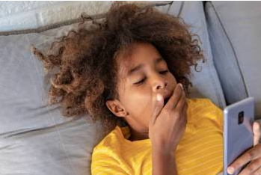
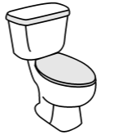
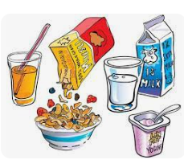
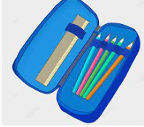
My Morning Routine
Parent wakes me up.
Go to the toilet.
Get dressed (underwear, blouse, tie, cardigan, blazer, skirt, socks/tights.)
Eat breakfast
Brush my teeth.
Brush my hair.
Pack my school bag. Don’t forget:
- workbooks
- pencil case
- PE kit
-trainers
Go to school

